Slide 1
Scheduling for the 8th grade
Syms Middle School

Slide 2
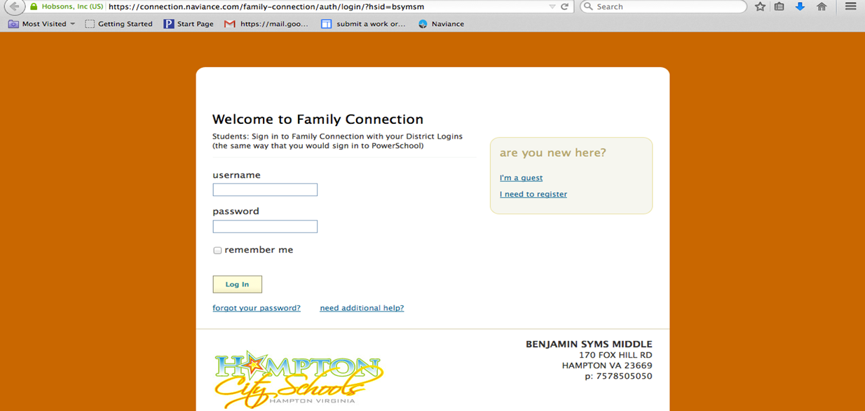
Cluster Finder Survey

Slide 3
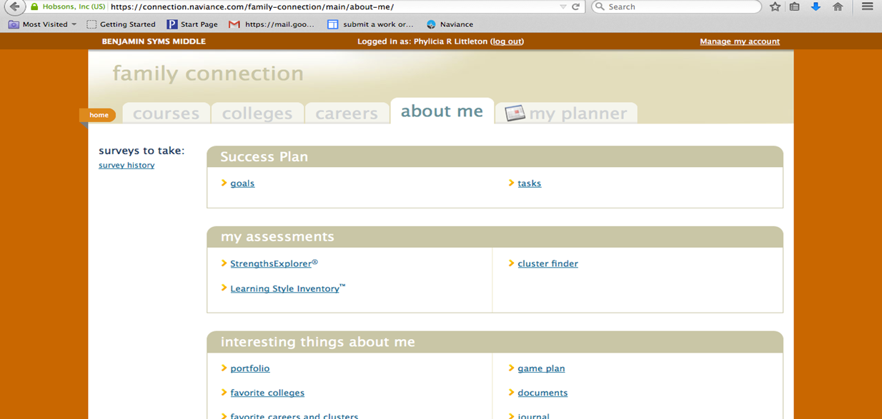
Cluster Finder Survey
Notes:
School Counselor passes out notecards to each student with Family Connection log-in information.
Students are asked to log-in and complete the Cluster Finder Survey.
School Counselor will wait until most students are finished and then ask the one who are finished to write the top three cluster choices on the Scheduling Exit Ticket and close their laptops.
Once all students have completed the assessment, school counselor will continue with the presentation.

Slide 4






Elective options for the 8th grade
ART 8 Course explores: Drawing, Painting, Clay, Jewelry making, Printmaking, Lettering, Graphics, & Paper-mache
  BUSINESS OF PRINCIPLES & MARKETING** Course explores: Marketing in a global economy; American business system; Making decisions as consumers, wage earners, and citizens; & Computer-based research projects
PLANNING MY FUTURE Course explores: Career plans, Nutrition, Conflict resolution, Change management, & Fashion
SPANISH II ** Course explores: Spoken and written information and ideas in Spanish, Verbal and nonverbal cues to interpret spoken and written word, & Cultural knowledge beyond the classroom setting
  TECHNOLOGICAL SYSTEMS Course explores: Info systems, Problem solving, & Careers and programs in technology
BAND 8 or CHORUS 8 Course explores: Experience with full ensemble, Tone, Immediate to advanced music reading, Practice and Rehearsal Skills, & Performance

Slide 5
Diploma requirements
Standard v. advanced studies
Standard diploma | Advanced diploma
22 credits | 26 credits
6 verified credits** | 9 verified credits**
4 yrs. of English 3 yrs. of Math 3 yrs. of Laboratory Sciences 3 yrs. of History and Social Sciences | 4 yrs. of English 4 yrs. of Math 4 yrs. of Laboratory Sciences 4 yrs. of History and Social Sciences
2 yrs. of P.E. | 2 yrs. of P.E.
2 yrs. of Foreign Language or Art | 3 yrs. of Foreign Language
1 yr. of Economics and Finance | 1 yr. of Economics and Finance
4 yrs. of Electives | 1 yr. of Fine Arts
 | 3 yrs. of Electives
Notes:
School Counselor will ask students “who plans to attend college after high school?” After, counselor will explain that anyone planning to attend a 4-year college or university should attempt to meet Advanced Diploma requirements to be competitive.

Slide 6


Career clusters
Agriculture, food, & Natural Resources
Careers: Vets, Agriculture Science Teachers, farmers, food inspectors
course offerings: Planning my future
Architecture & Construction
Careers: electrician, carpenter, construction, roofer
course offerings: Tech & Geometry
Notes:
School Counselor will make the connection between clusters and electives offered at the school.

Slide 7


Career clusters
Arts, a/v tech & communications
Careers: graphic artist, theater or music teacher, reporter, author, & musician
Course offerings: art, chorus, band, & Tech
Business, Management & Administration
Careers: Accountant, ceo, office manager, public relations, management analyst
Course offerings: Business of principle and marketing & planning my future

Slide 8


Career clusters
Education & Training
Careers: school counselor, teacher, college advisor, librarian, principal
Course offerings: English, math, history, & planning my future
Finance
Careers: appraiser, loan officer, tax preparer, & banker
Course offerings: math, tech, and business & Principles of marketing

Slide 9


Career clusters
Government & Public Administration
Careers: public works director, congressional aide, & legislative assistant,
Course offerings: Business & Principles of marketing
Health Sciences
Careers: pharmacist, nurse, dentist, physical therapist, athletic trainer
Course offerings: math, English, science, and planning my future

Slide 10


Career clusters
Hospitality & Tourism
Careers: camp counselor, travel agent, hotel manager, chef, and tour director
Course offerings: English, foreign language, and planning for the future
HR- human services
Careers: child care worker, substance abuse director, nutrition counselor, or clergy
Course offerings: business & principles of marketing, English, history, & tech

Slide 11


Career clusters
Information technology
Careers: computer system engineers, network system analyst, & web administration
Course offerings: math & Tech
Public safety & security
Careers: Attorney, correctional officer, detective, paralegal, probation officer
Course offerings: tech

Slide 12


Career clusters
Manufacturing
Careers: welder, textile inspector, laborer, industrial psychologist
Course offerings: math & Tech
Marketing, sales, & Service
Careers: Real estate agent, retail, sales manager, fashion model, & floral designer
Course offerings: Business & principles of marketing & planning my future

Slide 13


Career cluster
STEM
Careers: physicist, environmental scientist, aerospace engineer, & computer engineer
Course offerings: sciences, math, & tech
Transportation, Distribution, & Logistics
Careers: pilots, traffic tech, transportation specialist, & auto mechanic
Course offerings: math, Science, & Tech

Slide 14

Questions?

